Slide 1
Chapter 2
Creating Applications with Visual Basic

Slide 2
Topics
2.1 Focus on Problem Solving: Building the Directions Application
2.2 Focus on Problem Solving: Responding to Events
2.3 Modifying a Control’s Text Property with Code
2.4 The AutoSize, BorderSize, and TextAlign Properties
2.5 Displaying User Messages
2.6 Clickable Images
2.7 Using Visual Studio Help
2.8 Debugging Your Application

Slide 3
Focus on Problem Solving: Building the Directions Application
2.1

Slide 4
Building the Directions Application
The manager of the Highlander Hotel has asked you to build an application that displays a map to the hotel
You will use the following steps to create the application:
Clearly define what the application is to do
Visualize the application running on the computer and design its user interface
Determine the controls needed
Define the values of each control’s relevant properties
Start Visual Basic and create the forms and other controls

Slide 5
1. Define What the Application is to Do
Purpose: Display a map of the Highlander Hotel
Input: None
Process: Display a form
Output: Display on the form a graphic image showing a map

Slide 6
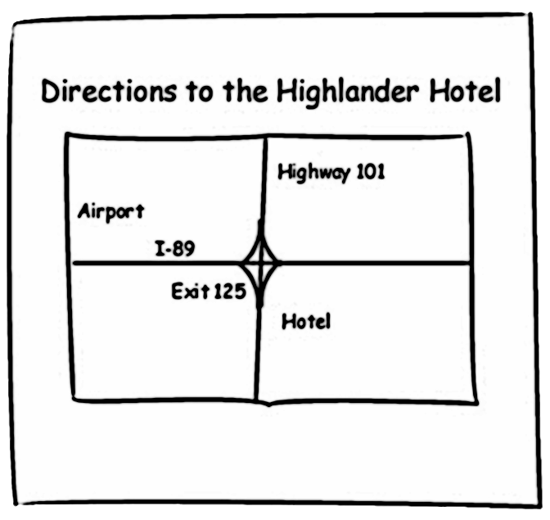
2. Visualize the Application and Design Its User Interface

Slide 7
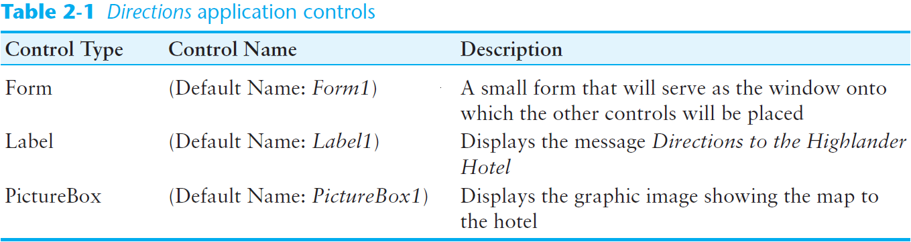
3. Determine the Controls Needed

Slide 8
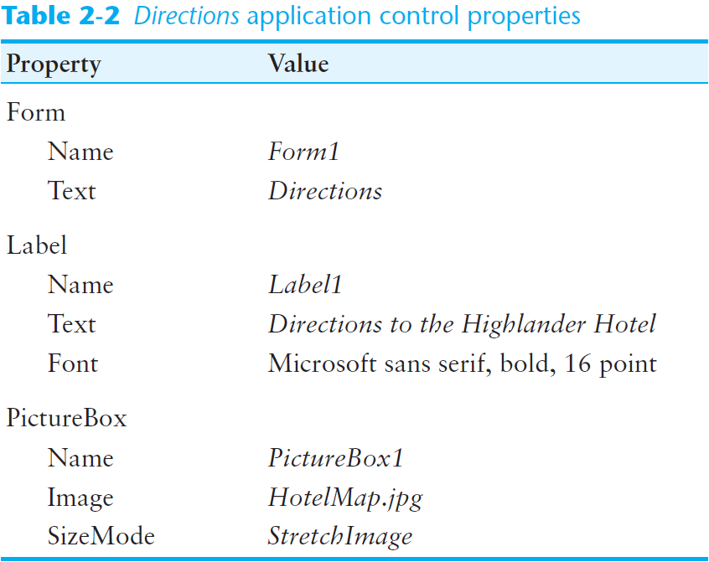
4. Define the Values of Each Control’s Relevant Properties

Slide 9
5. Start Visual Studio and Create the Forms and Other Controls
Establish the Form and set its Text property
Add a Label control
Position and resize it on the form
Set Text, TextAlign, and Font properties
Add a PictureBox control
Position and resize it on the form
Set its Image property to display HotelMap.jpg
Run the application
Close and save the application

Slide 10
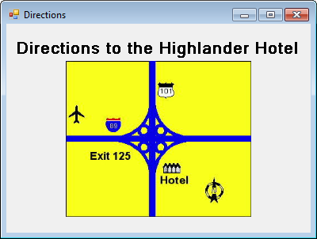
The Directions Application Running

Slide 11
Design Mode, Run Mode, and Break Mode
Visual Basic has three modes in which it operates:
Design Mode
The mode in which you create the application
Also known as design time
Run Mode
Executes the application in the Visual Studio environment
Also known as runtime
Break Mode
Momentarily suspends execution of a running application
For testing and debugging purposes

Slide 12


How Solutions and Projects are Organized
A solution is a container that holds Visual Studio projects
Each time you create a new project, you will also create a new solution to hold it
A solution folder is created for each new project
The solution folder contains:
The solution file and project folder
Double-clicking the solution file (.sln) will load the project in Visual Studio
The project folder contains:
Several files and folders generated by Visual Studio
The project file
Double-clicking the project file (.vbproj) will also load the project in Visual Studio

Slide 13
Opening an Existing Project
With Visual Studio running, perform any one of the following actions:
Click FILE then Open Project
Locate either the solution file (.sln) or the project file (.vbproj)
Click FILE then Recent Projects and Solutions
Select the solution file (.sln) or project file (.vbproj) from the list
Use the Start Page to open the project
If the start page is not visible, click VIEW then Start Page
Click the Open Project link or Select the name of the project in the Recent Projects list

Slide 14
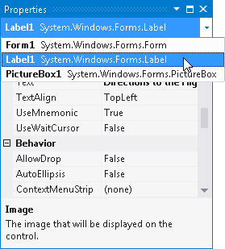
Using the Properties Window to Select Controls
The object box that appears at the top of the Properties window shows the name of the currently selected control
Clicking inside the object box displays a drop-down list showing the names of all the objects in the form
Clicking the name of an object selects it

Slide 15

Categorizing and Alphabetizing Properties
The Categorized and Alphabetical buttons affect the way properties are displayed
When the Alphabetical button is selected
The properties are displayed in alphabetical order
Most of the time it is easier to locate properties that are listed in alphabetical order
Frequently used properties are enclosed in parentheses and appear at the top of the list
When the Categorized button is selected
Related properties are displayed together in groups

Slide 16
Focus on Problem Solving: Responding to Events
2.2

Slide 17
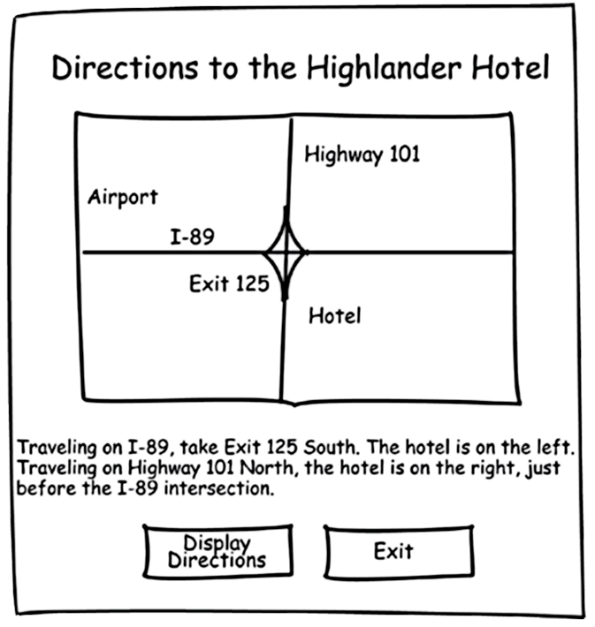
Modifying the Directions Application
The Highlander Hotel manager would like you to add the following items to the application:
A Label containing the written directions
A Button to display the directions
A Button to exit the application

Slide 18
Controls to be Added
Control Type Control Name Description Label lblDirections Displays written directions to the hotel
Button btnDisplayDirections When clicked, causes lblDisplayDirections text to appear on the form
Button btnExit Stops the application when clicked

Slide 19
Control Properties
Label
Name: lblDirections
Text: “Traveling on I-89,…etc”
Visible: False
Button
Name: btnDisplayDirections
Text: “Display Directions”
Button
Name: btnExit
Text: “Exit”

Slide 20
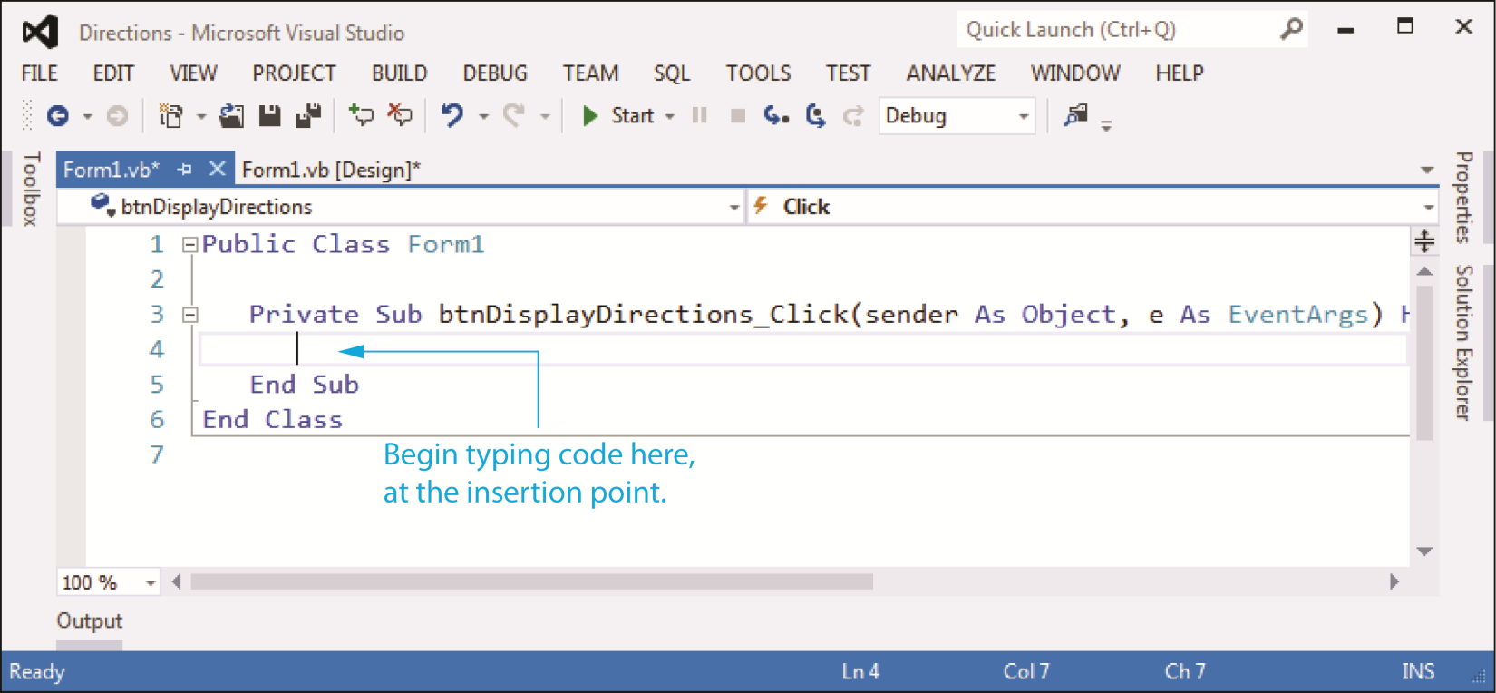
The Code Window
Double-clicking a control in design mode:
Opens the code window
Creates a code template for the control’s event handler where you fill in the code for the event

Slide 21
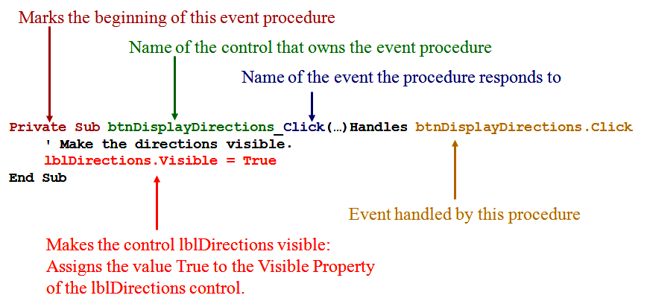
The Click Event Handler for btnDisplayDirections

Slide 22
Changing a Control’s Visible Property in Code
Specify the control name (lblDirections)
Then a dot (.)
Then the property name (Visible)
For example:
lblDirections.Visible
Refers to the Visible property of the lblDirections control
The Visible property is a Boolean property
It may only hold the value True or False

Slide 23
The Assignment Statement
Specify the item to receive the value (value on the left)
Then the equal symbol (=)
Known as the assignment operator
Then the value to be assigned (value on the right)
For example:
lblDirections.Visible = True
Assigns the value True to the Visible property of the lblDirections control
Causes the text of the lblDirections control to become visible to the user

Slide 24
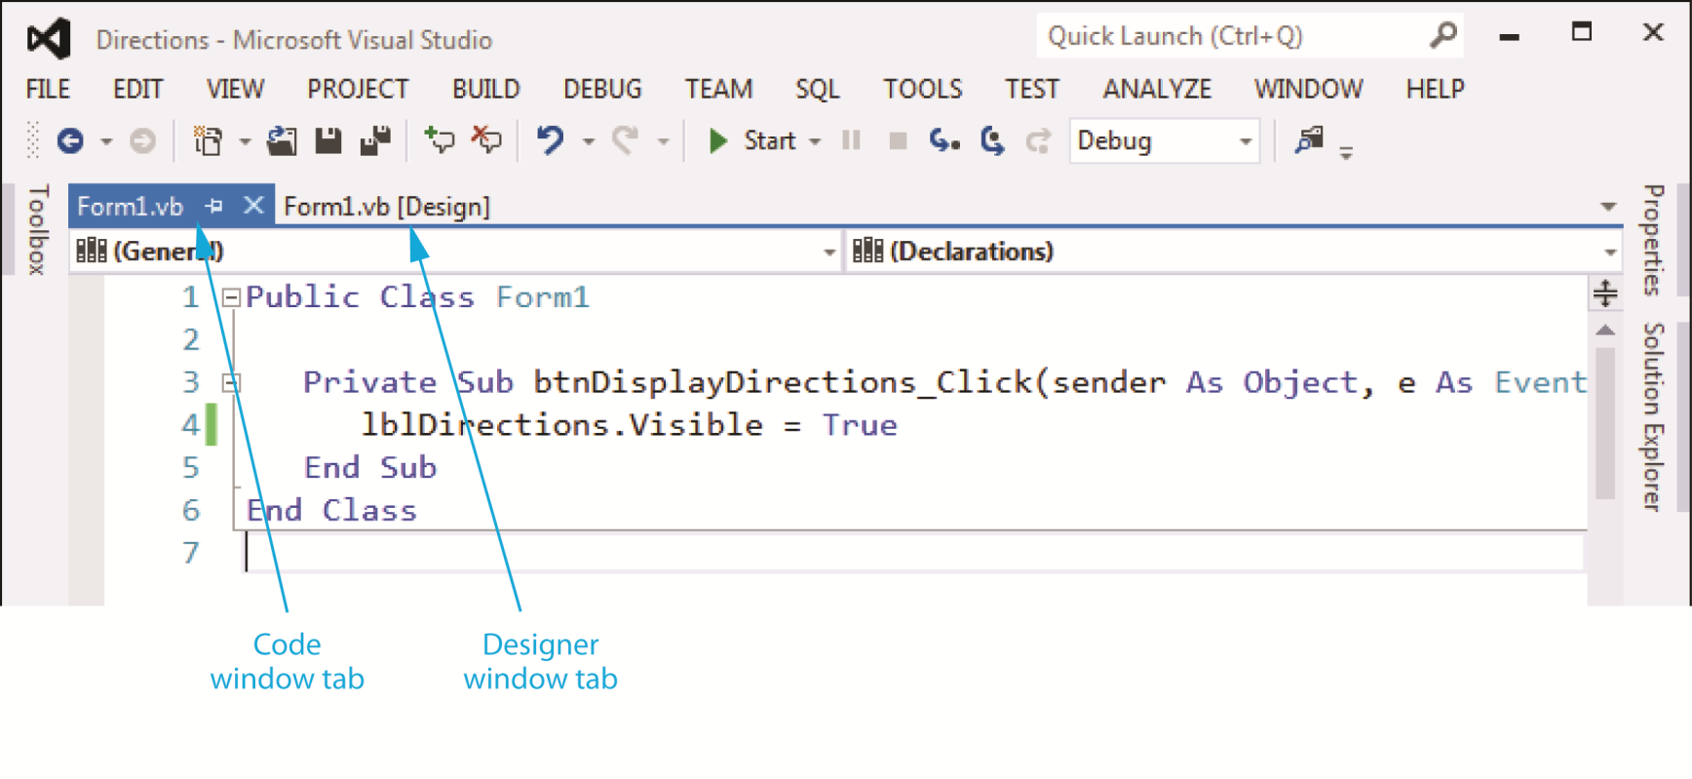
Switching Between the Code Window and the Designer Window
To switch to the Designer window, click the tab that reads Form1.vb [Design]
To switch to the Code window, click the tab that reads Form1.vb

Slide 25
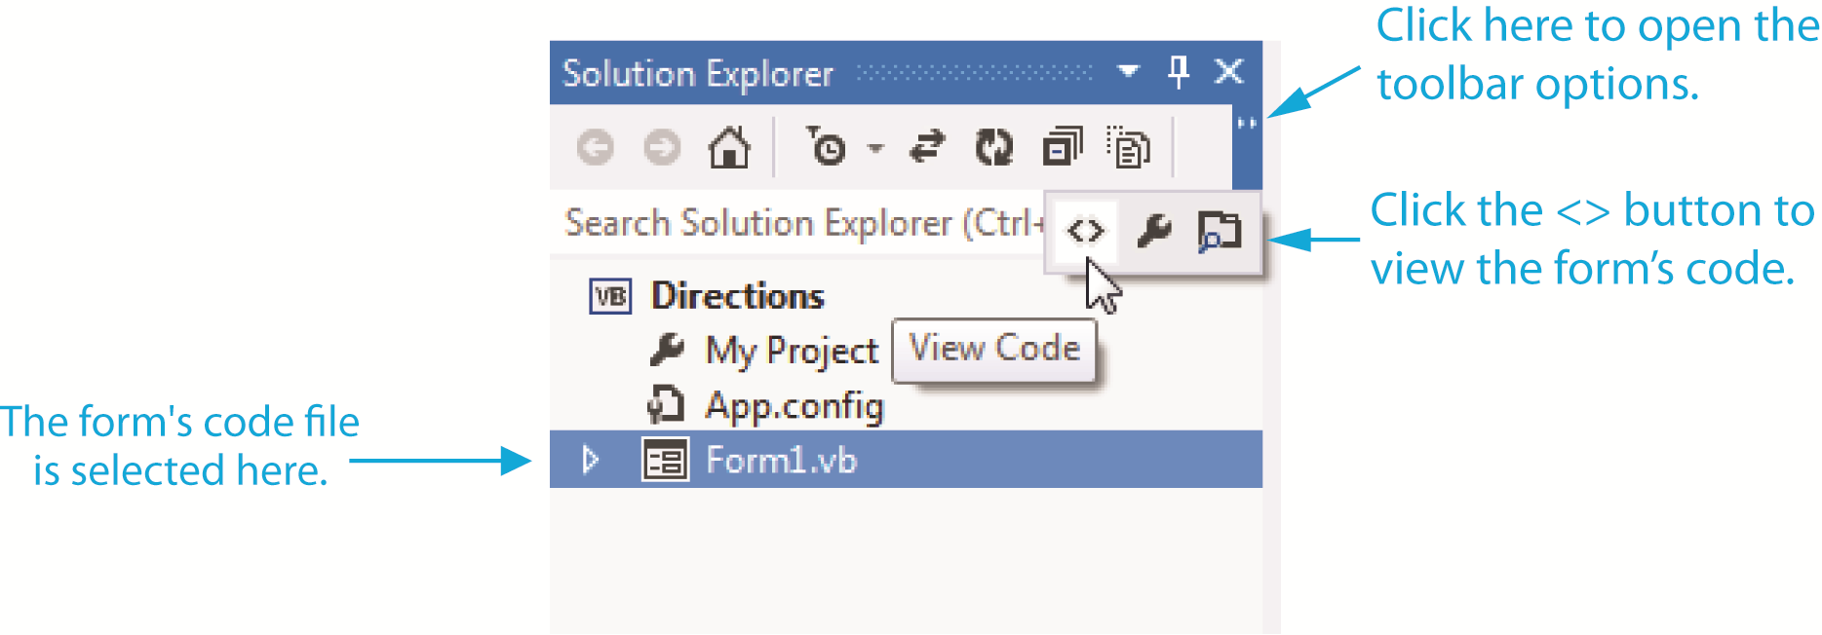
More Ways to Switch Between the Code Window and the Designer Window
Use the Solution Explorer to open the Code window
You can also perform any of the following actions:
Click VIEW on the menu bar then select either Code or Designer
Press Shift +F7 on the keyboard to open the Designer window
Press Ctrl + Alt + 0 to open the Code window

Slide 26
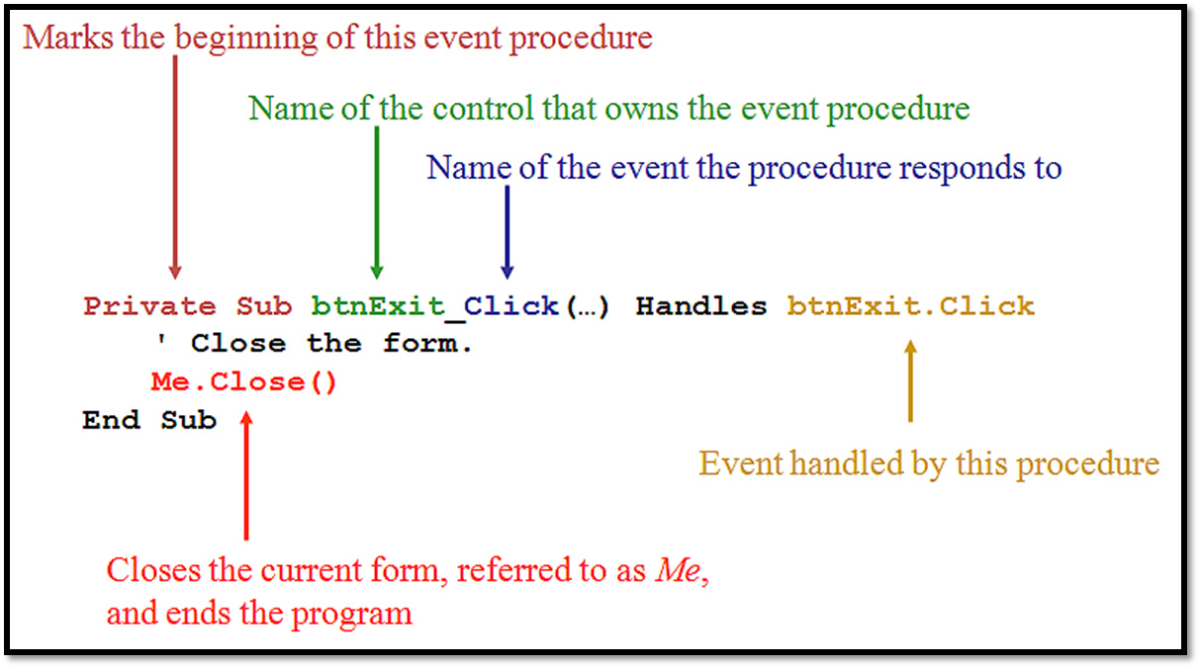
The Click Event Handler for btnExit

Slide 27
Ending an Application with Me.Close()
An application’s form is an object that has a method named Close
When a form’s Close method is called, it causes the form to close
If the application has only one form, it also ends the application
For example:
Me.Close()
The keyword Me refers to the current form
Followed by a dot (.)
Then the word Close
Followed by a set of parentheses ()
Parentheses () always appear after the name of the method in a method call

Slide 28

Comments
Comments or remarks are short notes that you can write in the application’s code to explain what the code does
A comment starts with an apostrophe (')
Anything appearing after the apostrophe, to the end of the line, is ignored by the compiler
A comment can also be inserted at the end of a programming statement

Slide 29
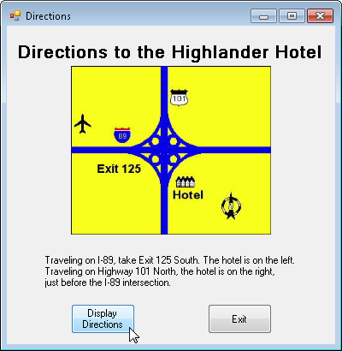
Use Visual Basic to Update the Application
Place the label and the buttons on the form
Enter the code for the event handlers
Test the application

Slide 30
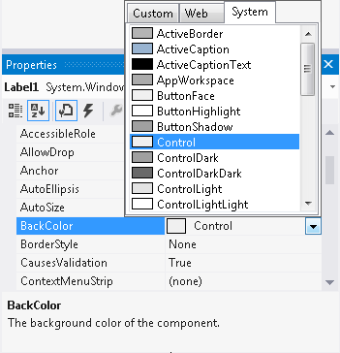
Changing Text Colors
The BackColor property sets the background color
The ForeColor property sets the text color
In the Properties window:
Select a color property
Click the down-arrow button that appears
Select a color from the list

Slide 31
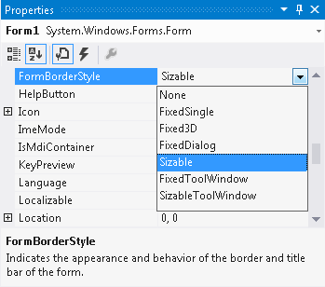
Changing the Form’s Appearance
The FormBorderStyle Property
Sizable: (Default)
Has Maximize, Minimize, and Close buttons
May be resized by dragging edges
FixedSingle:
Has single line border, Maximize, Minimize, and Close buttons
May not be resized

Slide 32
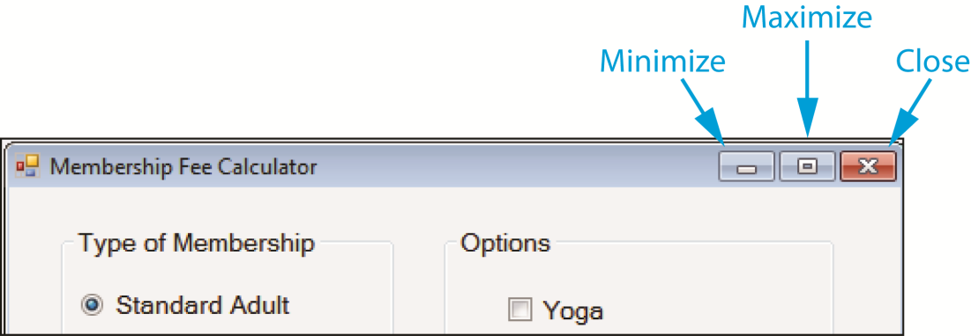
Changing the Form’s Appearance
The MinimizeBox Property (Boolean)
Hides the Minimize button when set to False
Is disabled but shown if MaximizeBox is set to True
The MaximizeBox Property (Boolean)
Hides the Maximize button when set to False
Is disabled but shown if MinimizeBox is set to True
The ControlBox Property (Boolean)
Hides all buttons when set to False

Slide 33

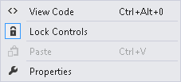

Locking Controls
Locking controls prevents them from being moved around during design time
To lock controls:
Right-click an empty space on the form
Select Lock Controls from the menu

Slide 34
Printing Your Code
To print a project’s code:
Open the Code window
Click FILE on the menu bar
Click the Print command
Using the keyboard shortcut:
Open the Code Window
Press Ctrl + P on the keyboard to print

Slide 35
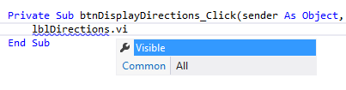
Using IntelliSense
IntelliSense is a feature that provides automatic code completion as you type programming statements
Press the Tab key to use IntelliSense
For Example:

Slide 36
Modifying a Control’s Text Property with Code
2.3

Slide 37
Modifying a Control’s Text Property with Code
Suppose a form is established with a label lblMessage whose Text property is:
1 Kilometer = ?
And on a btnFeet button click, we want to change the value of the text property to:
1 Kilometer = 3,281 feet

Slide 38
Modifying a Control’s Text Property with Code
Private Sub btnFeet_Click(…) Handles btnFeet.Click
' Display the conversion to feet.
lblMessage.Text = "1 Kilometer = 3,281 feet"
End Sub
Assigns the string to the right of the equal sign to the Text property of lblMessage
This replaces the previous Text property of lblMessage with the new value shown

Slide 39
The AutoSize, BorderStyle, and TextAlign Properties
2.4

Slide 40
The AutoSize Property
AutoSize is a Boolean property
When set to True: (default)
The bounding box will automatically resize itself to fit the amount of text assigned to it
When set to False:
The label’s size may be changed in the Designer window with its sizing handles
The bounding box will remain the size it was given at design time
Text that is too large to fit in the bounding box will be only partially displayed

Slide 41

The BorderStyle Property
The Label control’s BorderStyle property determines the appearance of the label’s border and may have one of three values:
None (default)
The label will have no border
FixedSingle
The label will be outlined with a border one pixel wide
Fixed3D
The label will have a recessed 3D appearance

Slide 42
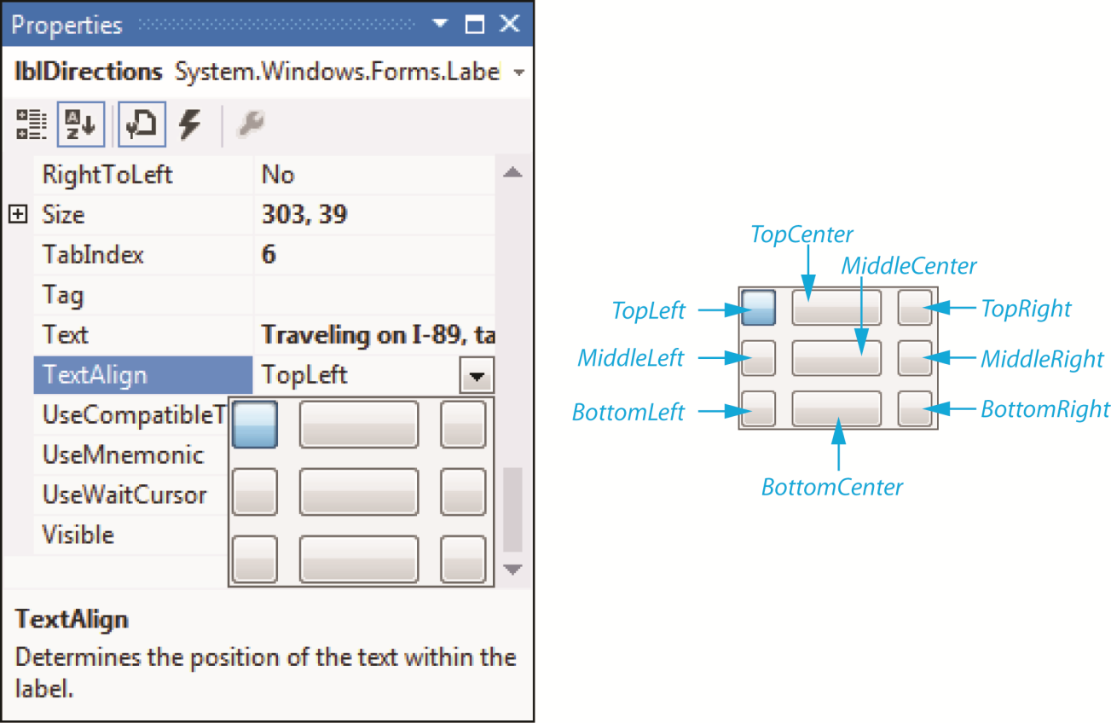
The TextAlign Property
The value of the TextAlign property changes the way a label’s text is aligned

Slide 43
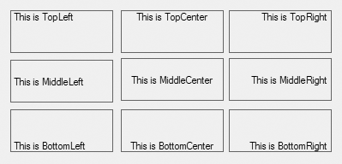
The TextAlign Property
The TextAlign property may be set to one of the following values:
TopLeft (default)
TopCenter
TopRight
MiddleLeft
MiddelCenter
MiddleRight
BottomLeft
BottomCenter
BottomRight

Slide 44
Changing a Label’s TextAlign Property with Code
You can use an assignment statement to assign one of the following values to the TextAlign property of a Label control:
For example:
ContentAlignment.TopLeft
ContentAlignment.TopCenter
ContentAlignment.TopRight
ContentAlignment.MiddleLeft
ContentAlignment.MiddleCenter
ContentAlignment.MiddleRight
ContentAlignment.BottomLeft
ContentAlignment.BottomCenter
ContentAlignment.BottomRight

Slide 45
Displaying User Messages
2.5

Slide 46
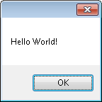
Displaying Message Boxes
A message box is a small pop-up message window
Sometimes referred to as a dialog box
A convenient way to display a message to the user
Displayed by calling the MessageBox.Show method
User must click the OK button to remove the message box
MessageBox.Show("Hello World!")
MessageBox
dot
Show
string enclosed in parentheses

Slide 47
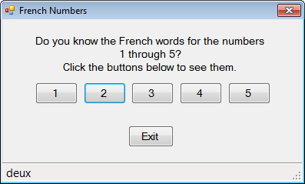
The StatusStrip Control
The StatusStrip control uses a Label to display program status information and messages to the user
An ideal way to display messages that are not system critical
Does not force the user to click a button to clear the message
StatusStrip

Slide 48
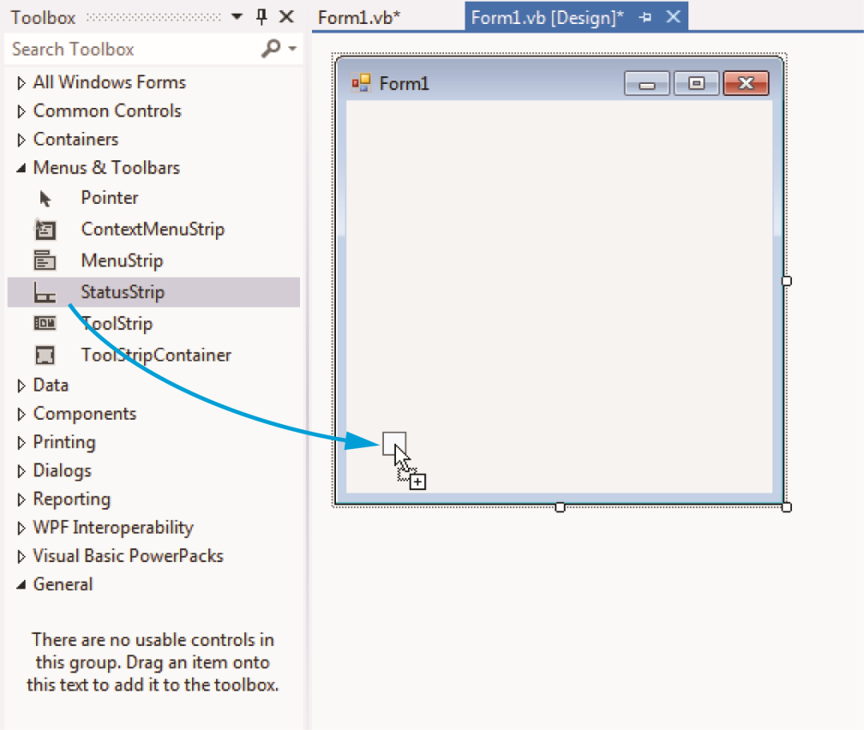
Adding a StatusStrip and a Label to a Form
Step 1:
Drag the StatusStrip control from the Menus & Toolbars section of the Toolbox window onto an existing form.
The StatusStrip will attach itself to the bottom of the form
This is called docking the control

Slide 49
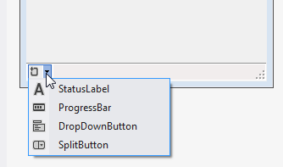
Adding a StatusStrip and a Label to a Form
Step 2:
Click the down arrow on the right side of the StatusStrip and select StatusLabel from the drop-down list
A ToolStripStatusLabel control will be added to the StatusStrip
Set its Name property with a more meaningful name
Clear its Text property

Slide 50
Clickable Images
2.6

Slide 51
Writing Click event handlers for PictureBox controls
Earlier you learned that buttons can have Click event handlers
Other controls, such as PictureBoxes and Labels, may also have Click event handlers
As we saw earlier the Image Property can be set to a graphic image of some sort
The flag images in Tutorial 2-16 are clickable
The click event can be handled by code to take whatever action is desired

Slide 52
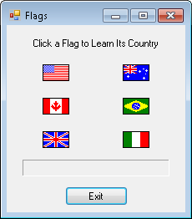
Form1 of the Flags Project
Label1
picUSA
picAustralia
picCanada
picBrazil
picUK
picItaly
lblMessage
btnExit

Slide 53
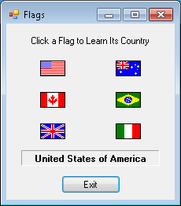
PictureBox Click Event Handler
When PictureBox picUSA is clicked, the lblMessage Text property is set to display United States of America
Private Sub picUSA_Click(…) Handles picUSA.Click
' Display United States of America.
lblMessage.Text = "United States of America"
End Sub

Slide 54
Using Visual Studio Help
2.7

Slide 55
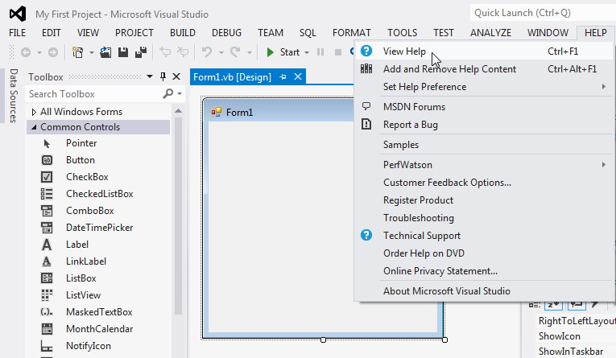
Accessing the Visual Studio Documentation

Slide 56
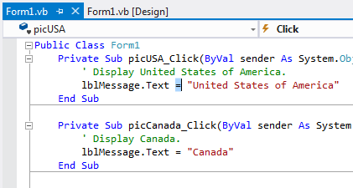
Context-Sensitive Help
Context-sensitive help is help on a single topic that you are currently working on
First select an item you need help with in Visual Studio
Then press the F1 key on the keyboard
This launches a help screen in your Web browser

Slide 57
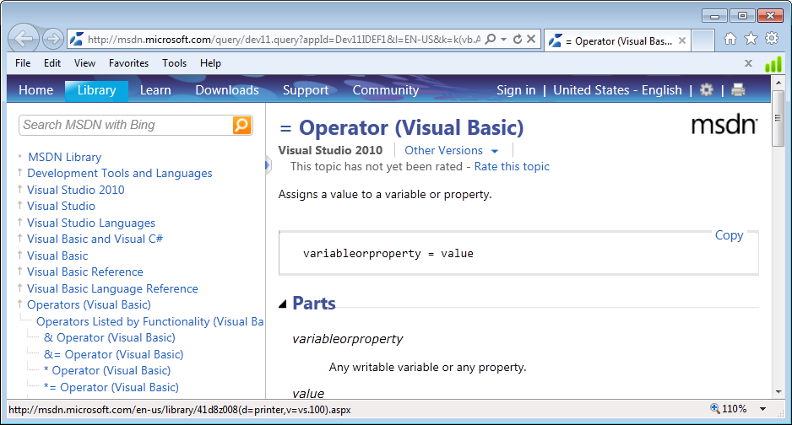
Help on the = Operator

Slide 58
Debugging Your Application
2.8

Slide 59

Compile Errors
These are errors in the syntax of your program
Misspelled keywords, incorrect use of operators or punctuation
Visual Basic will inform you of these errors as soon as the code is entered
The area of the error will be underlined with a jagged blue line

Slide 60
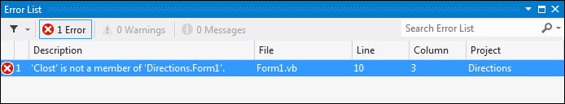
Compile Errors
A description of the error will be given in the Error List window
Display this window by selecting VIEW on the menu bar, and then selecting Error List
Double-clicking the error message will position the cursor at the error in the Code window

Slide 61
Runtime Errors
Some errors occur as your program runs
These are different from syntax errors which occur as the code is entered by the programmer
Runtime errors occur when Visual Basic attempts to perform an operation that cannot be executed

